Slide 1
Final Thesis Video Presentation
Model for MRI-Based Detection and classification of
Parkinsonian Tremor and PIGD
By
Anjali
Student ID : 113089
Master in Data Science April 2024
LIVERPOOL JOHN MOORES UNIVERSITY
Under supervision of
Jayesh Himmatbhai Munjani

Slide 2
Introduction and Problem Statement
Parkinson's disease (PD) is a developing Nervous system-degenerative condition and core neural network dysfunction that often impacts movement
It is the second most common neurodegenerative disease after Alzheimer
Disease starts because of loss of dopamine in brain
PD disease is more seen in aged people, and it affects the lifestyle of the patient
It mainly slows down the movement’s tremors balance problems
It also effects senses, thinking ability, mental health and more
The disease cannot be cured completely but it can be controlled and lifestyle can be improved

Slide 3
Introduction and Problem Statement
Major motor and non-motor symptoms are mentioned in table below
These symptoms are often confused with other age relate disease
The causes of Parkinson’s disease are largely unknown, except the smaller number of inherited cases
It becomes difficult for health professional to understand which of the many motor and non-motor problems are major troublesome
Non-Motor Symptoms |  |  | Motor Symptoms
Loss of smell | Drooling | Constipation | Slowed movements | Tremor while muscle are at rest | Rigidity or stiffness
gastrointestinal problems | Sleep problems | Mask like facial expression | Blinking less often than usual | Trouble swallowing | Unstable posture or walking gait

Slide 4
Aim and Objectives
The aim of the research is to create and evaluate deep learning models for the preliminary & accurate identification and classification of Parkinson’s disease using MRI image data.
The research objectives are mentioned below:
To identify the most significant clinical and imaging
To suggest an effective data balancing technique.
To develop machine learning models to detect Parkinson’s disease and classify between tremor and PIGD.
To evaluate the performance of the developed

Slide 5
LITERATURE REVIEW
Researches has done survey, debates and conferences to address the issue of Parkinson.
Survey has been done by Lisa A Uebelacker with 75 patients with Parkinson’s disease Lisa A Uebelacker et al., n.d.).
National French survey was conducted by stela to investigate diagnosis announcement impact on huge patient with Parkinson (Dodaj et al., 2024) .
Debate and discussion has happened among two researchers on the change in the definition of Parkinson disease with the expansion of clinical phenomenology and improved understanding of environmental and genetic influences (Peter Jenner et al., 2013).

Slide 6
LITERATURE REVIEW
Original Definition | Modern definition 1
James Parkinson, and modified by Jean-Martin Charcot | Tanya Simuni and Anthony Lang
1960 | 2024
Clinical definition | Biological definition
Disorder which is likely to respond to dopaminergic therapies, and this therapeutic response in turn confirms the working diagnosis | The availability of pathologic neuronal alpha-synuclein in cerebrospinal fluid (CSF). Patients with pathologic neuronal alpha-synuclein have high probability of dopaminergic neuronal dysfunction SynNeurGe biological classification of PD

Slide 7
LITERATURE REVIEW
Two important conferences happened in the year 2024:
The Grand Challenges in Parkinson’s
International Congress of Parkinson’s Disease and Movement Disorders
Broad spectrum of points were discussed in the conference are mentioned below:
genetics behind PD and other movement disorders
disease modifying therapies
clinical trials
Better understanding of the biology of neurodegenerative disorders
co-morbid health conditions including mood disorders and gastrointestinal issues
Major discussion was to improve the understanding of how genes play a role in the development of PD
GBA1 is a gene which generates Gcase enzyme
Enzyme plays key role in causing of PD
Studies was done in European communities

Slide 8
LITERATURE REVIEW
Multiple studies which are going on are mentioned below:
Detecting disease using biological and genetic method
combining physiotherapy and cognitive behavioural therapy
Most of the researches are either on going or tested in lab. Hence cannot be implemented in real world
Other researcher groups working on creating a model to detect disease using:
voice & Speech analysis
walking pattern
handwriting pattern
Year
Research
Limitation
2022
Govindu & Palwe has done research on detection of Parkinson's disease using audio signal through machine learning
2023
Naanoue et al. has done research on detecting disease from speech analysis using deep learning
limited sample size
2016
Pereira et al. has worked on diagnosing disease using handwritten dynamics
Incomplete and inaccurate
Dataset is small

Slide 9
LITERATURE REVIEW
Other researcher groups working on creating a model to detect disease using MRI images
Research in this paper is done with large dataset
Year
Research
Limitation
2023
Sangeetha et al.
2023
Xiong et al.
Dataset is very small
2018
Tagaris et al. has done research on ,
Dataset has missing items and images are not of excellent quality.
Dataset sample was small.

Slide 10
METHODOLOGY
Detection and classification of Parkinson using MRI images goes through multiple steps as shown in diagram below
Dataset utilized in the study is downloaded from Parkinson’s Progression Markers initiative i.e., PPMI website (http://www.ppmiinfo.org)
MRI scan raw images needs to be pre-processed before using it for modelling for better accuracy:
Cropping
Resizing
Filtering
Normalization
Dataset collection
Image data segmentation
Model Evaluation
model classification
Pre-Processing
Image data generator

Slide 11
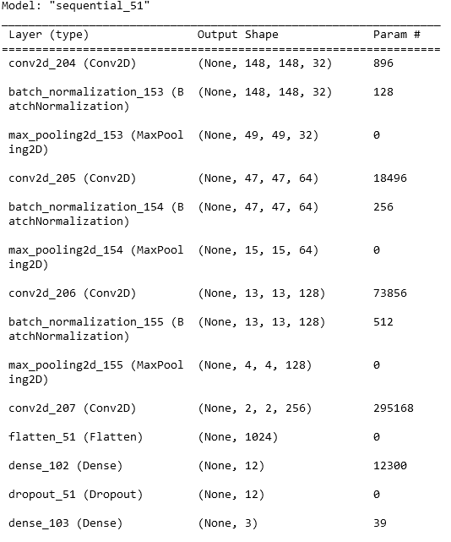
METHODOLOGY
Dataset is split into training and testing dataset
Image dataset is transformed as mentioned below:
Rotation
Translation
Flip
Zoom
Brightness adjustment
Model classification is done using convolution
neural network. It uses four convolution network, filter,
kernel , pooling, activation function etc. Detailed
convolution network is mentioned in figure.
Pre-trained model like ResNet and DenseNet has also
been used disease detection and classification

Slide 12
METHODOLOGY
Model is evaluated using below metrics:
Accuracy
Precision
Recall
F score

Slide 13
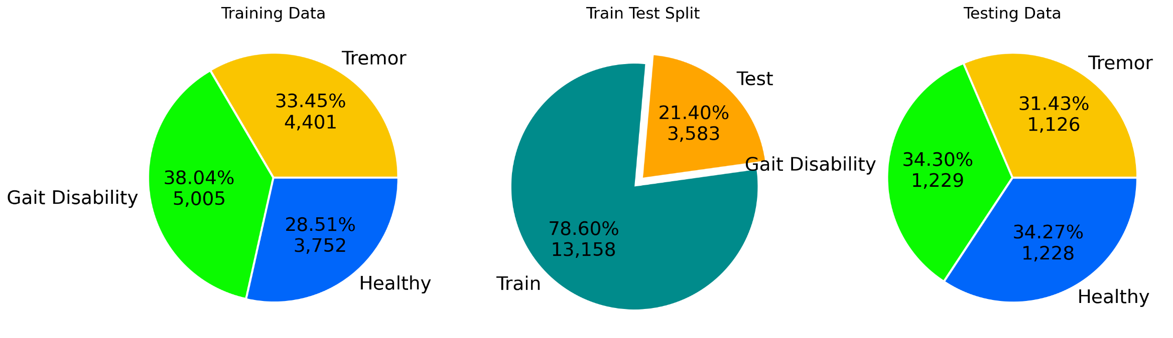
ANALYSIS
Dataset downloaded from PPMI website is converted into png format
Dataset is divided between detection of disease and classification of disease
Classification of disease dataset is classified into three categorical classes Tremor, gait Disability and Healthy subtype as shown in figure below and Detection of disease dataset is classified into two categorical classes Disease and Healthy subtype
Image is resized into required format

Slide 14
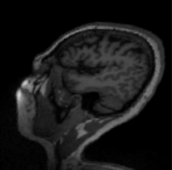
ANALYSIS
Data Augmentation applied on training data are :
Rotation
Brightness Adjustment
Width and height shift
Shear Transformation
Zoom
Horizontal Flipping
Training data setup is defined and calculated before modelling
shape
batch size
Number of epochs
training steps per epoch
validation steps per epoch

Slide 15
ANALYSIS
CNN model architecture, DenseNet and ResNet is applied on transformed dataset
Adam optimizer and learning hyperparameter is applied on model
Multiple callbacks are used on model are:
learning rate scheduler
early stopping
reduce learning rate on plateau
Model checkpoint

Slide 16
RESULT AND DISCUSSION
Validation dataset result obtained from image detection model is mentioned below
Validation dataset result obtained from image classification model is mentioned below
Metric | Healthy | Disease
Accuracy | 0.78
Precision | 0.818 | 0.764
Recall | 0.717 | 0.852
F1-Score | 0.764 | 0.805
Metric | Healthy | Gait Disability | Tremor
Accuracy | 0.5
Precision | 0.712 | 0.116 | 0.417
Recall | 0.629 | 0.007 | 0.9
F1-Score | 0.668 | 0.012 | 0.57

Slide 17
RESULT AND DISCUSSION
Accuracy of test result in disease detection model is ~80%, because:
MRI images dataset is not in consistent format
MRI sample was not correct
Poor quality of image
Accuracy of test result in disease classification model is very poor because
Difference between Gait Disability and Tremor subtype is not related to brain
It has behavioral difference

Slide 18
CONCLUSION AND RECOMMEDATION
Study has focused on developing a Convolution neural network model to detect and classify Parkinson disease using MRI images.
The accuracy achieved is very low and had its own challenges during modelling.
Model can be used by practitioner as support tool by flagging potential Parkinson patient
To enhance real-world application, future work will focus on:
Expanding the dataset with more diverse of MRI scans
Incorporating better quality of data
Incorporating consistent format of data
standardizing MRI data formats and orientations to ensure consistency during training and inference.
Modification in CNN architecture will help in good results.
Model classification performance should be tested and evaluated with combination of MRI images and behavioural or clinical data

Slide 19
REFRENCE
Lisa A Uebelacker, Gary Epstein-Lubow, Trevor Lewis, Monica K Broughton & Joseph H Friedman (n.d.). A survey of Parkinson’s disease patients: most bothersome symptoms and coping preferences . Uebelacker LA, Epstein-Lubow G, Lewis T, Broughton MK, Friedman JH. A survey of Parkinson’s disease patients: most bothersome symptoms and coping preferences. J Parkinsons Dis. 2014;4(4):717-23. doi: 10.3233/JPD-140446. PMID: 25271239
Dodaj, S., Fabbri, M., Doe de Maindreville, A., Foubert-Samier, A., Toussaint, M.C., Carriere, N., Lopez, J., Giroud, M., Sattler, V., Gerdelat, A., Baille, G., Turc, J.D., Barthelemy, C., Scotto d Apollonia, C., Fabre, M.H., Eytier, E., Thiriez, C., Fluchère, F. & Ory-Magne, F. (2024). Survey on Parkinson’s Disease Diagnosis Impact: Patients, Caregivers and Health Care Professionals’ Perspectives. Journal of Clinical Medicine. 13 (14)
Peter Jenner, Huw R Morris & Trevor W Robbins (2013). Parkinson’s disease--the debate on the clinical phenomenology, aetiology, pathology and pathogenesis . national library of medicine.
Tagaris, A., Kollias, Di., Stafylopatis, A., Tagaris, G. & Kollias, S. (2018). Machine Learning for Neurodegenerative Disorder Diagnosis - Survey of Practices and Launch of Benchmark Dataset. International Journal on Artificial Intelligence Tools. 27 (3)
Sangeetha, S., Baskar, K., Kalaivaani, P.C.D. & Kumaravel, T. (2023). Deep Learning-based Early Parkinson’s Disease Detection from Brain MRI Image. In: Proceedings of the 7th International Conference on Intelligent Computing and Control Systems, ICICCS 2023. 2023, Institute of Electrical and Electronics Engineers Inc., pp. 490–495.
Xiong, J.;, Zhu, H.;, Li, X.;, Hao, S.;, Zhang, Y.;, Wang, Z.;, Xi, Q., Corbo, D., Sone, D., Leung, C.K., Xiong, J., Zhu, H., Li, X., Hao, S., Zhang, Y., Wang, Z. & Xi, Q. (2023). Citation: Auto-Classification of Parkinson’s Disease with Different Motor Subtypes Using Arterial Spin Labelling MRI Based on Machine Learning. [Online]. Available from: https://doi.org/10.3390/brainsci

